Slide 1
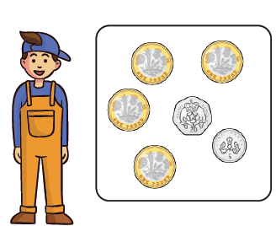
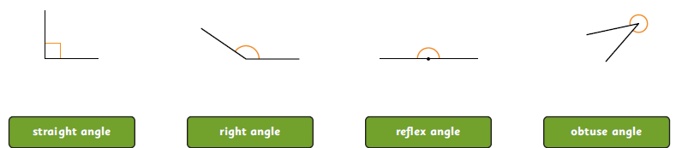
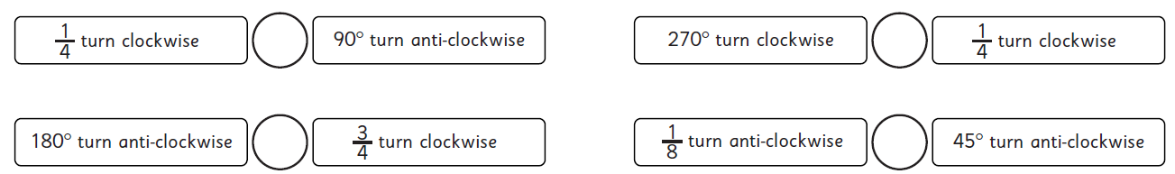
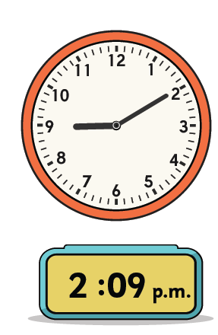
Year 5 Homework A – 6th June 2025
Remember to also have a go at TTRS.
Forgotten your login? Let me know!
Money
Work out how much money Shen has.
Angles
Match these angles to the correct name.
Addition and Subtraction
Use <, > or = to compare the size of turns in these statements.
Time
Miss P has worked out the digital time from the analogue clock.
What mistake has she made?
7 x 4 = .
4 x 2 = .
6 x 9 = .
9 x 12 = .
2 x 7 = .
5 x 4 = .
2 x 8 = .
0 x 8 = .
Multiplication
36 ÷ 12 = .
24 ÷ 7 = .
21 ÷ 3 = .
222 ÷ 1 = .

