Slide 1
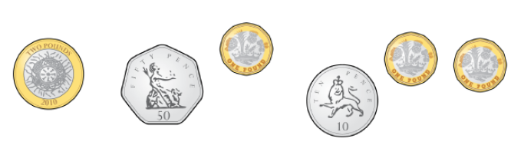
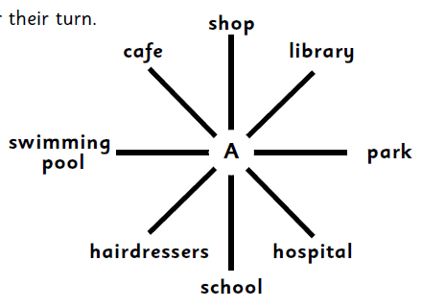
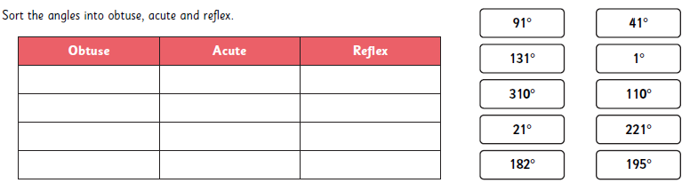
Remember to also have a go at TTRS.
Forgotten your login? Let me know!
Year 5 Homework B – 6th June 2025
Multiplication
Reasoning
9 x 4 = .
5 x 7 = .
6 x 12 = .
4 x 6 = .
11 x 12 = .
6 x 8 = .
63 ÷ 7 = .
12 ÷ 4 = .
33 ÷ 3 = .
10 x 9 = .
12 x 3 = .
7 x 11 = .
11 x 8 = .
678 x 0 = .
142 x 1 = .
108 ÷ 9 = .
104 ÷ 1 = .
322 ÷ 322 = .
Money
Work out where each person is standing after they have turned.
a) Yusuf is facing the shop. He turns 180° clockwise.
b) Yara is facing the park. She turns 270° clockwise.
c) Keira is facing the hairdressers. She turns 45° anti-clockwise.
d) Mark is facing the school. He turns 90° anti-clockwise.
Inaya has this money. She is given £2.23 more.
How much money does she have now?
Angles
Sort the angles into obtuse, acute and reflex.

