Slide 1
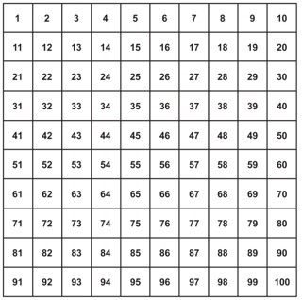
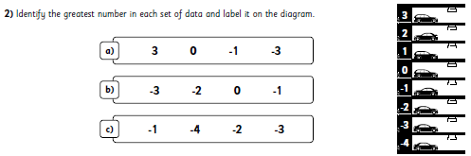
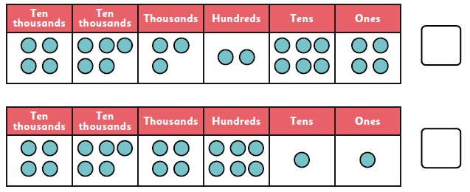
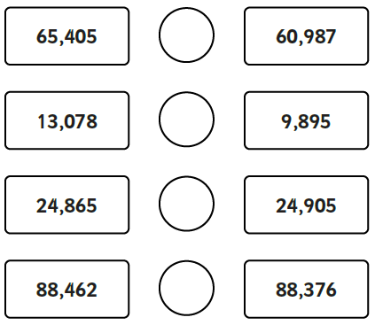
Year 5 Homework B – 19th September 2025
Remember to also have a go at TTRS!
Forgotten your login? Let me know!
Multiplication
9 x 5 = .
10 x 5 = .
12 x 5 = .
3 x 5 = .
4 x 5 = .
6 x 5 = .
5 x 12 = .
7 x 5 = .
5 x 2 = .
1 x 5 = .
11 x 5 = .
5 x 5 = .
Negative Numbers
Identify the greatest number in each set and label on the car park.
Place Value
2. Circle the greater number in each pair.
1. Tick the greater number:
Addition and Subtraction
Tth | Th | H | T | O
 | 3 | 4 | 5 | 2
+ | 2 | 6 | 3 | 9
Tth | Th | H | T | O
 | 7 | 8 | 6 | 5
- | 2 | 9 | 3 | 7
How do you know which one is greater?

