Slide 1
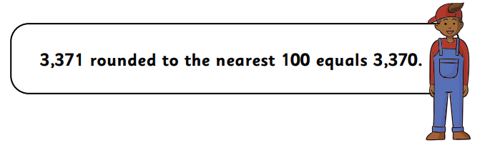
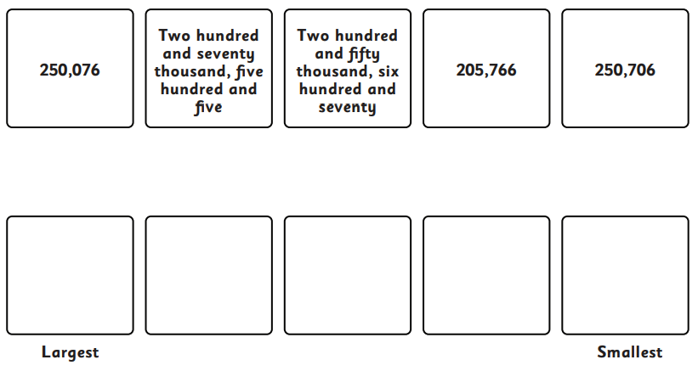
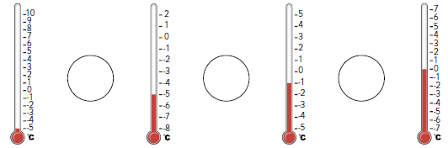
Remember to also have a go at TTRS!
Forgotten your login? Let me know!
Year 5 Homework A – 19th September 2025
Addition and Subtraction
Multiplication
Tth | Th | H | T | O
 | 3 | 4 | 5 | 2
+ | 2 | 6 | 3 | 9
Tth | Th | H | T | O
 | 4 | 3 | 0 | 2
- | 4 | 1 | 3 | 3
3 x 6 = .
6 x 5 = .
9 x 4 = .
12 x 3 = .
2 x 2 = .
4 x 7 = .
12 ÷ 12 = .
15 ÷ 3 = .
25 ÷ 1 = .
6 x 8 = .
10 x 11 = .
8 x 10 = .
5 x 9 = .
1 x 8 = .
0 x 7 = .
72 ÷ 8 = .
28 ÷ 7 = .
48 ÷ 4 = .
Reasoning
3642 rounded to the nearest hundred is 3500.
What mistake has Noah made?
What would the correct answer be?
What is 3642 rounded to the nearest thousand?
Place Value
Put these values in descending order:
Negative Numbers
Use symbols <,> or = to compare each temperature.

