Slide 1
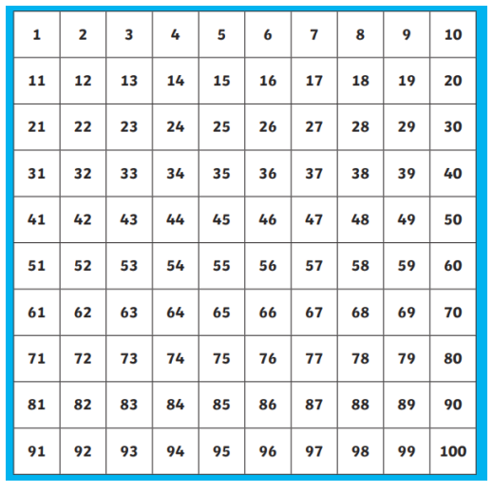
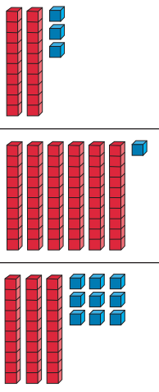
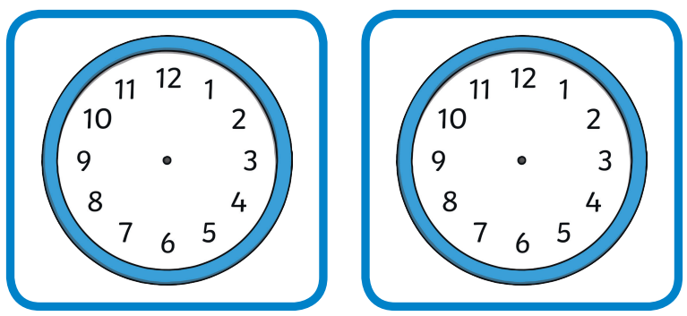
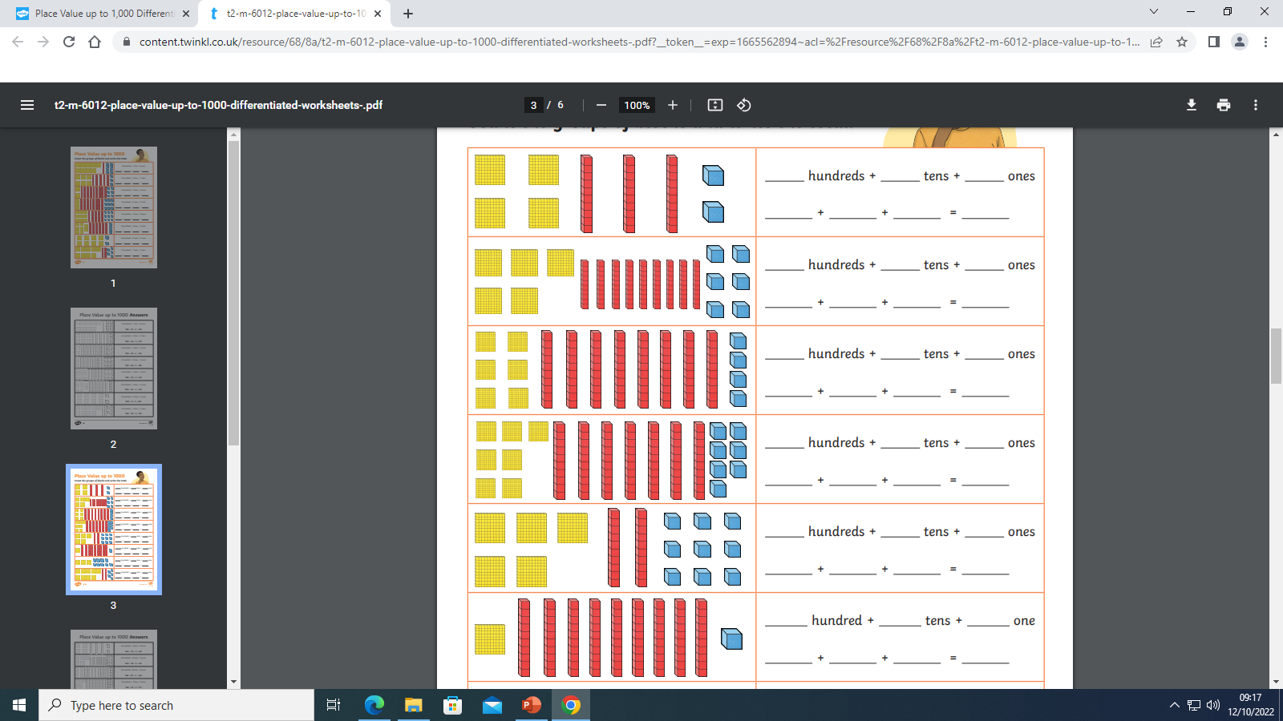
Write down the number being represented
Draw the hands on the clocks to show the times below
6 o’clock
Half past 3
If I count in 10’s from 0. what comes after 90?
Count in 2’s and circle all of the multiples of 2
Count in 4’s and underline all of the multiples of 4
Challenge! Try the one below
What is the name of the shape?
How many sides?
How many corners?
Is it a quadrilateral?

Slide 2
Write down the number being represented
Draw the hands on the clocks to show the times below
Half past 3
Quarter past 7
If I count in 100’s from 0, would the number 340 come up? Explain your answer
Count in 4’s and underline all of the multiples of 4
Count in 8’s and circle all of the multiples of 8
What is the name of the shape?
How many sides?
How many corners?
Is it a quadrilateral?
List the types of triangles you know

