Slide 1
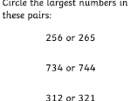
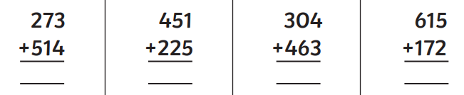

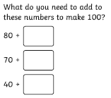
Complete the calculations below
What is the 10th month?
What is the 6th month?
How many minutes in an hour?
How many days in a week?
How many weeks in a fortnight?
How many months in the year?
A clock shows 10:30. What two numbers would the hands of the clock be pointing to?
What is the shape?
How many sides?
How many corners?
Is it a quadrilateral?
Is it 2D or 3D?

Slide 2
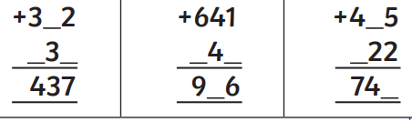
Complete the calculations below
What is the shape?
How many sides?
How many corners?
Is it a quadrilateral?
Is it 2D or 3D?
Challenge! Fill in the missing numbers
What is the shape?
How many sides?
How many corners?
Is it a quadrilateral?
Is it 2D or 3D?
Dance class starts at 15:15. It is currently quarter past one. How long do I have to wait?
How many minutes would that be?
What is the 10th month?
What is the 6th month?
How many months are there in a year?
How many days are in a fortnight?
Create a word problem using the numbers 265 and 313.

