Slide 1
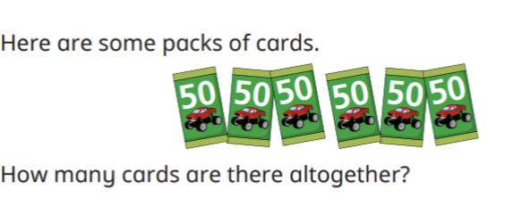
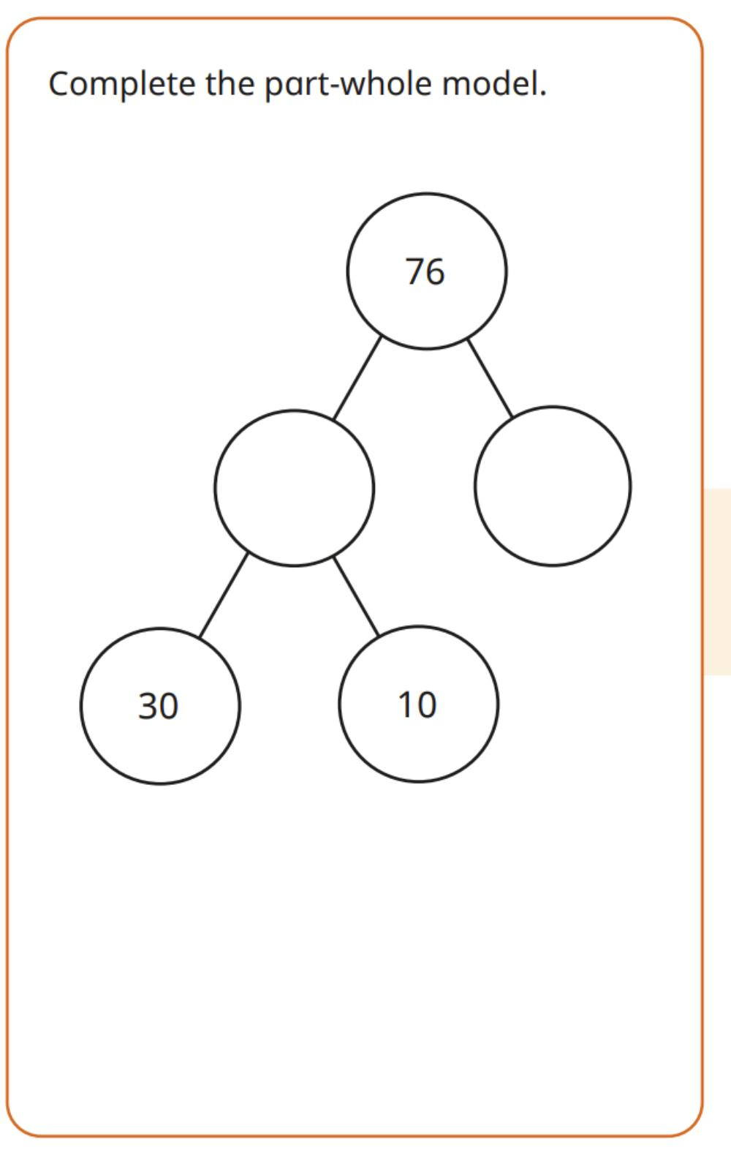
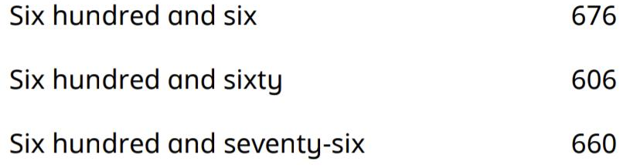
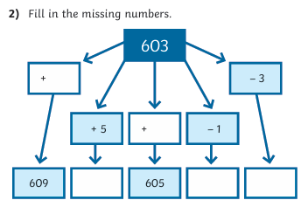
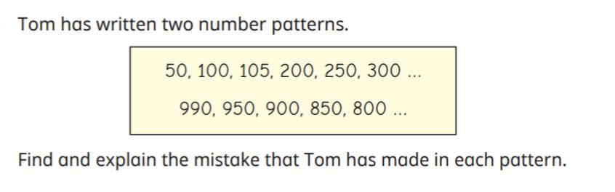
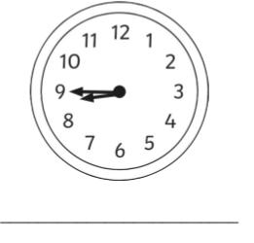
What is the shape called?
How many sides?
How many corners?
Is it a quadrilateral?
Match the words to the correct digits
Practise counting in 4’s from 0
0, 4,
What month comes before September?
What time is it?
What time would it be in 15 minutes?

Slide 2
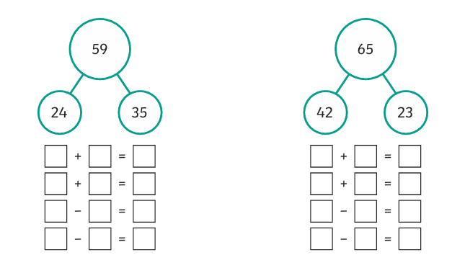
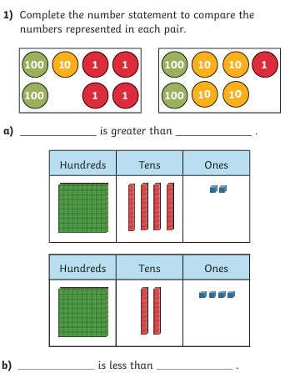
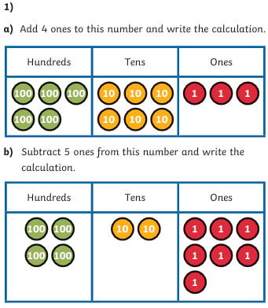
What month comes before September?
Practise counting in 4’s from 0
0, 4,
What is the shape called?
How many sides?
How many corners?
Is it a quadrilateral?
Match the words to the correct digits

