Slide 1
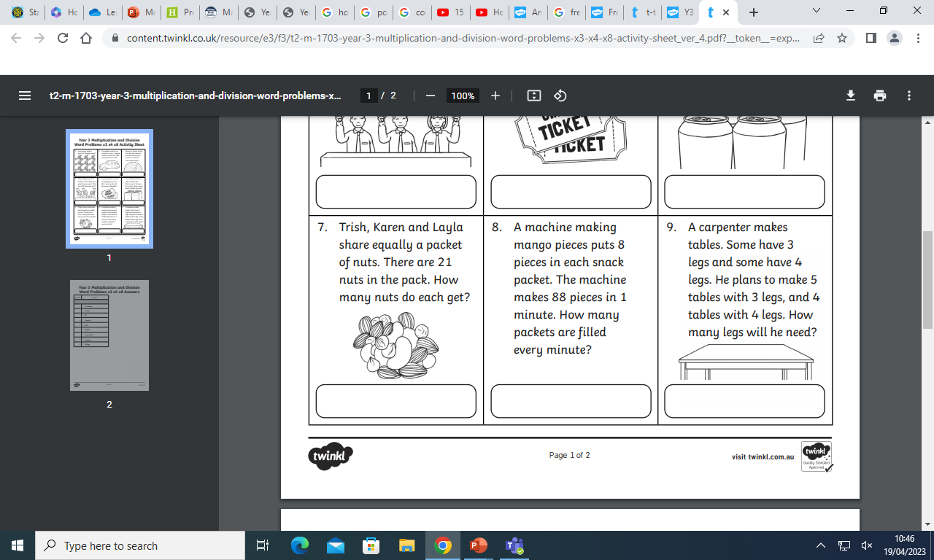
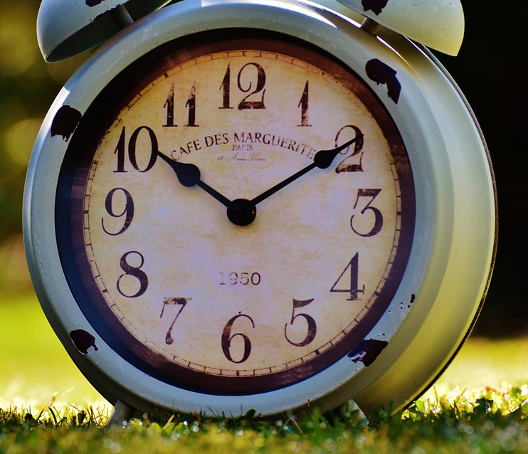
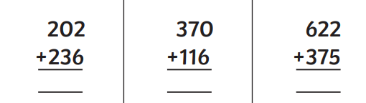
Draw a line that is 7cm long.
How long is this line?
__________________
Remember to draw it, if you need to
What time is it?
How many minutes are in an hour?
What would be best to use to measure a bench? Circle your answer
MM CM M

Slide 2
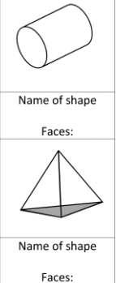

How long is this line in cm?
Draw a line that is 45 mm long.
Are these shapes 2D or 3D?
What time is it?
Break time is at 10:30, how many minutes until then?
School starts at 9:05am, how many minutes has it been since then?

