Slide 1
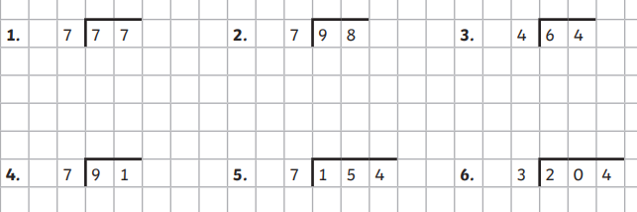
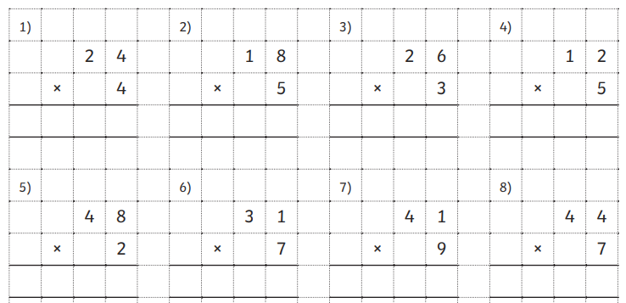
Miss D buys 349 crackers.
Mrs Jackson buys 457 crackers.
How many crackers are there altogether?
How many days are in January and October altogether?
McDonald’s makes 789 burgers.
They sell 492.
How many do they have left?
I am a shape with 7 sides. What am I?
Count in 8’s starting from 0

Slide 2

Use whichever method you like to work out the division questions below.
How many days are there in September?
What shape is has 4 sides where all sides are the same length?
Is it 2D or 3D?
Is it a quadrilateral?
Miss D buys 342 crackers.
Mrs Jackson buys 256 crackers.
How many crackers are there altogether?
How many minutes are in half an hour?

