Slide 1

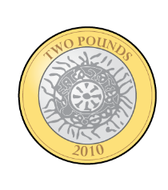

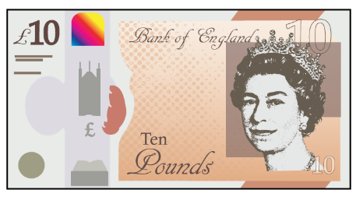

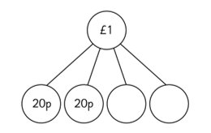

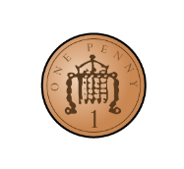
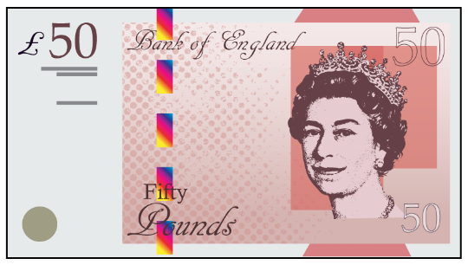



Name: _____________________
Can you complete a robot in Numbots to gain a certificate next week?
Year 2 homework 06.03.25
Return by 13.03.25
Multiplication
Equal groups
2 groups of 2 =
3 groups of 2 =
5 groups of 2 =
6 groups of 2 =
8 groups of 2 =
9 groups of 2 =
___ groups of 2 = 20
1 x 2 =
2 x 2 =
3 x 2 =
4 x 2 =
5 x 2=
1 x 5 =
2 x 5 =
3 x 5 =
4 x 5 =
5 x 5 =
1 x 10 =
2 x 10 =
3 x 10 =
4 x 10 =
5 x 10 =
Continue the pattern
4, 6, 8, 10, __, __, __, __
15, 20, 25, __, __ , __
50, 60, 70, __, __, __
Double 3 =
Double 6 =
Double 12 =
Double 10 =
Double 4 =
Double 5 =
Double 8 =
Double 7 =
Double 1 =
Double 0 =
Complete the model
How many cakes?
Shape
Complete the sentences.
The pattern has 3 ______________________.
The pattern has 1 ______________________.
Spellings: swan quantity wart worse worship
Notes:
1

Slide 2
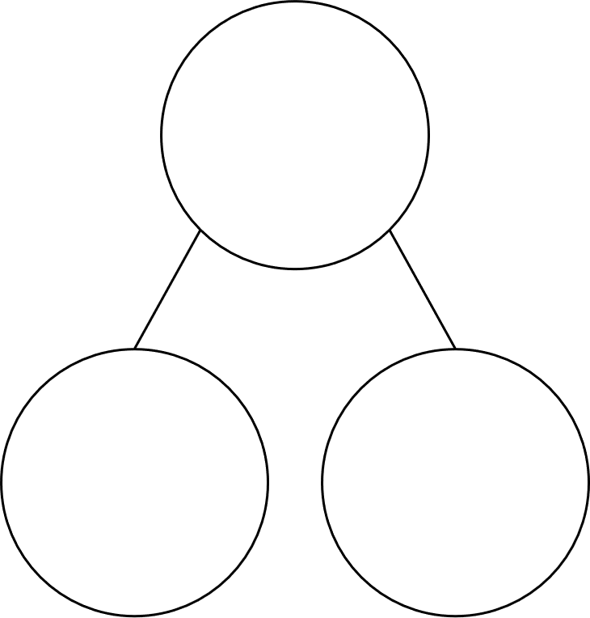
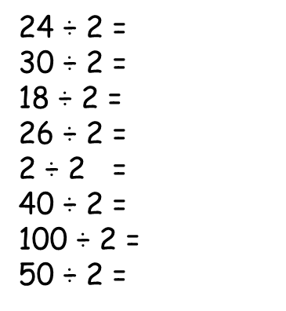
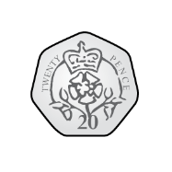


Name: _____________________
Year 2 homework 07.03.24
Return by 14.03.24
Addition and subtraction
26 + 24 =
19 + 41 =
90 + 10 =
76 + 14 =
Can you make £10 in three different ways?
30 - 13 =​
50 - 23 =​
60 - 33 =​
70 - 43 =
£10
£10
Division
Divide means share into equal groups
4 ÷ 2 =
10 ÷ 2 =
14 ÷ 2 =
8 ÷ 2 =
12 ÷ 2 =
16 ÷ 2 =
6 ÷ 2 =
20 ÷ 2 =
£10
Order from the smallest to greatest
Multiplication
1 x 3 =
3 x 2 =
3 x 5 =
3 x 10 =
5 x 3 =
3 x 4 =
Shape
Complete the sentences.
Write these numbers in words.
11
12
13
14
The pattern has 3 ______________________.
The pattern has 1 ______________________.
Notes:
2

Slide 3
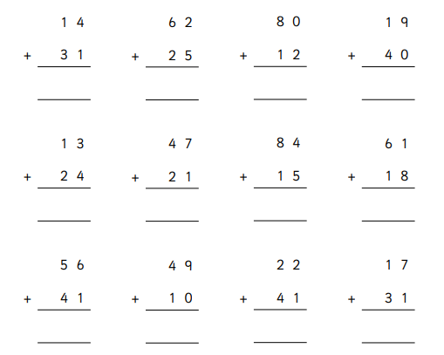

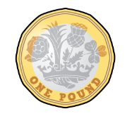
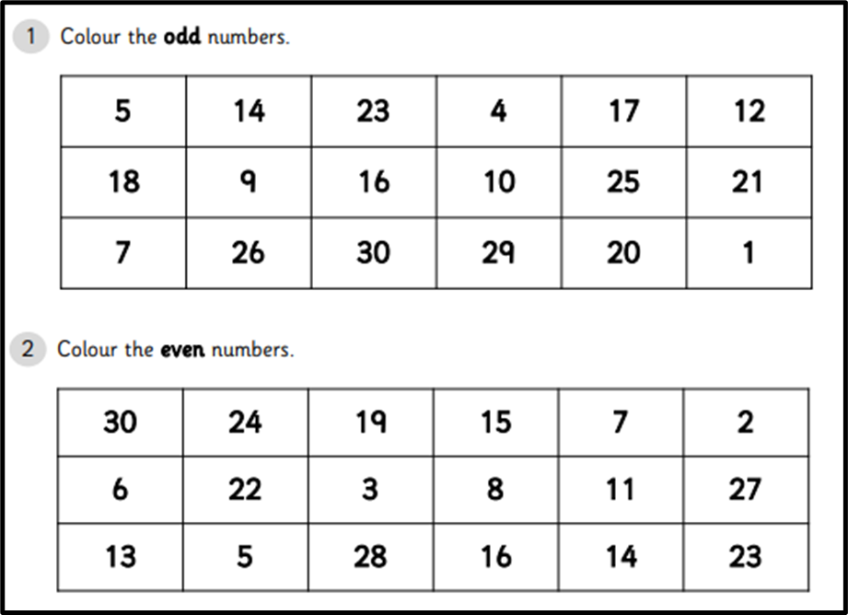
Name: _____________________
Year 2 homework 14.03.24
Return by 21.03.24
Division
Divide means share into equal groups
100 ÷ 10 =
80 ÷ 10 =
70 ÷ 10 =
60 ÷ 10 =
20 ÷ 10 =
30 ÷ 10 =
10 ÷ 10 =
40 ÷ 10 =
30 ÷ 5 =
25 ÷ 5 =
5 ÷ 5 =
10 ÷ 5 =
20 ÷ 5 =
15 ÷ 5 =
50 ÷ 5 =
40 ÷ 5 =
Shape
Complete the sentences.
The pattern has 3 ______________________.
The pattern has 1 ______________________.
Notes:
3

Slide 4


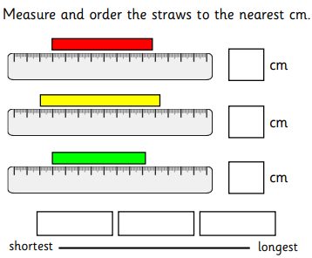
Name: _____________________
Year 2 homework 21.03.24
Return by 28.03.24
Multiplication and division
10 x 2 =
10 x 5 =
10 x 10 =
10 ÷ 2 =
10 ÷ 5 =
10 ÷ 10 =
2 x 2 =
5 x 2 =
10 x 2 =
2 ÷ 2 =
14 ÷ 2 =
10 ÷ 2 =
On the back of this sheet write out your
2 times tables
5 times tables
10 times tables
Can you write the inverse?
Shape
Complete the sentences.
The pattern has 3 ______________________.
The pattern has 1 ______________________.
Notes:
4

